Slide 1
The Problem
Insurance is risky for providers and inaccessible, complicated and slow for consumers.

Slide 2
Why?(Providers)
Low Population Densities in many areas makes setting up branches too costly for most companies.
Lack of efficient, cost effective distribution methods.
Lack of efficient payment mechanism for premiums etc
Lack of knowledge of the needs of the customer.
Difficult to verify documents for applications and claims. E.g. Identities, Invoices etc

Slide 3
Why?(Consumers)
Lack of knowledge. 85% of people haven’t even heard of insurance!
Lack of understanding of understanding what insurance is.
Poor accessibility. For those in sparsely populated areas, especially rural, the nearest insurance company could be over an hour away. Location matters a lot.
Very slow transactions e.g. processing of claims.
No plans available that suit their needs etc…

Slide 4

Our Solution
mango

Slide 5
What is mango?
Mango is a multiplatform (Android, iOS, Windows… not Blackberry) , multi-device (Smartphone and Feature Phone) that enables allows users to manage all their insurance needs in one place. It:
Allows users to browse and buy insurance from multiple insurance companies from anywhere in the country.
Enables users to pay their premiums in almost any way they are comfortable with (Zoona, mobile money, Calling Credit etc) from anywhere.
Lets users file claims and upload documents while getting quicker response times.
Gives users updates on the state of their plans e.g. Claim/Application decisions, Payment reminders, confirmations etc.
Gives them all the information they need to know to learn about insurance and it’s benefits.
Great customer service…. and more

Slide 6
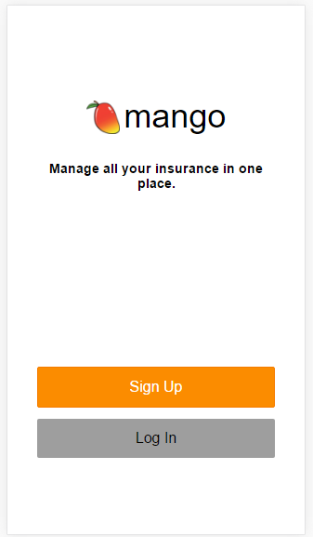
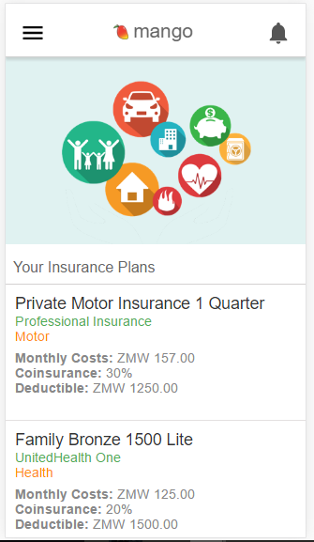
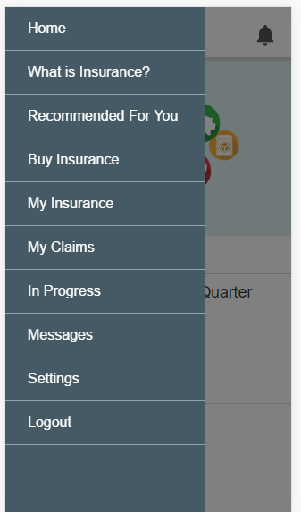
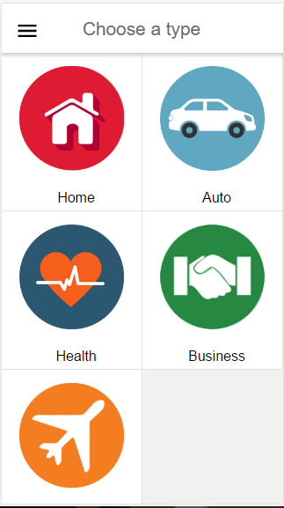

Slide 7
